Slide 1








1
2
3
4
5
6
7
8

Slide 2








Slide 4
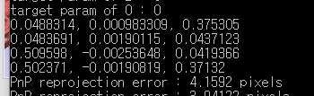
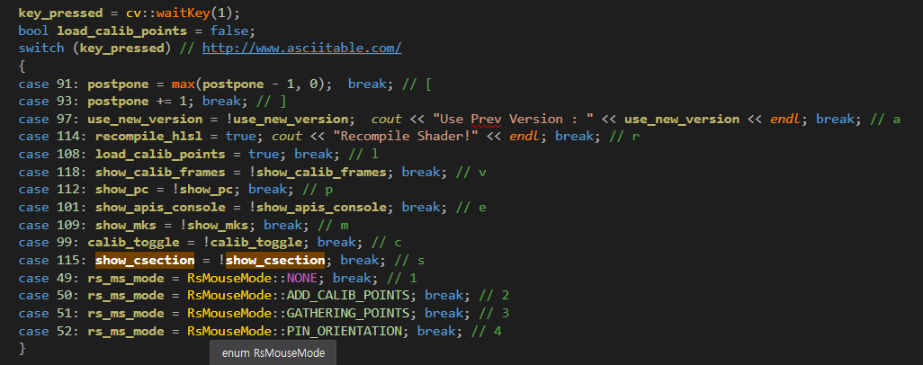

Slide 5
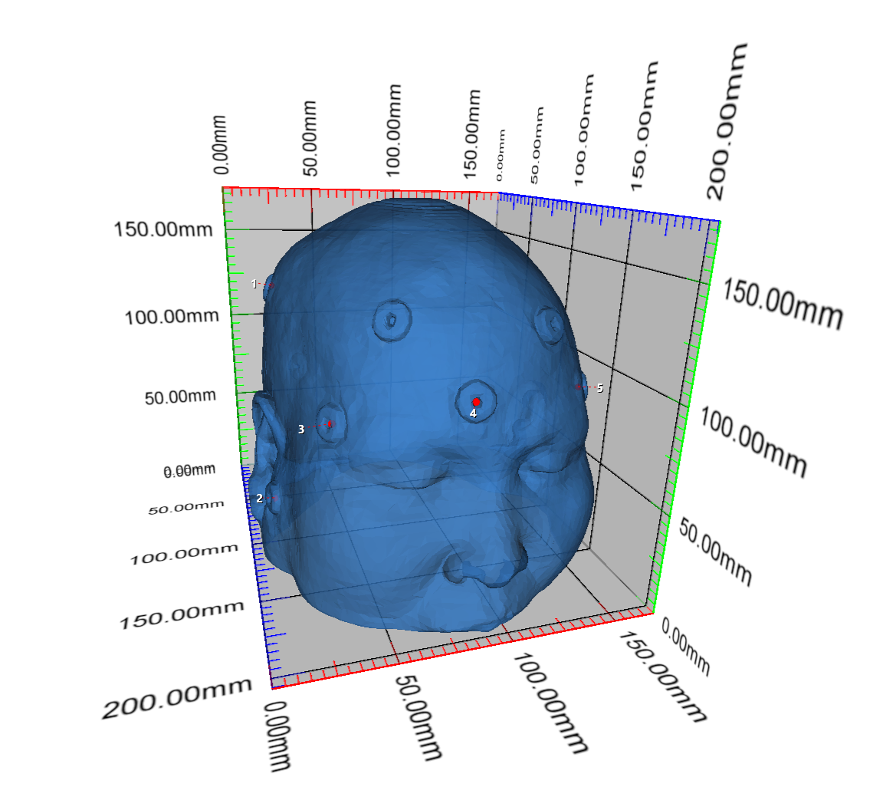
5
-66.0194014740086 41.806037902832 -38.4074830877672
-74.4731513694261 -47.1128196716309 23.9858883324019
-53.112073168685 2.0620265007019 59.3263342992975
-2.03481305799799 17.3925399780273 87.6095285787495
67.5338788309431 5.05584383010864 46.6503649764105
default world space positions

Slide 6
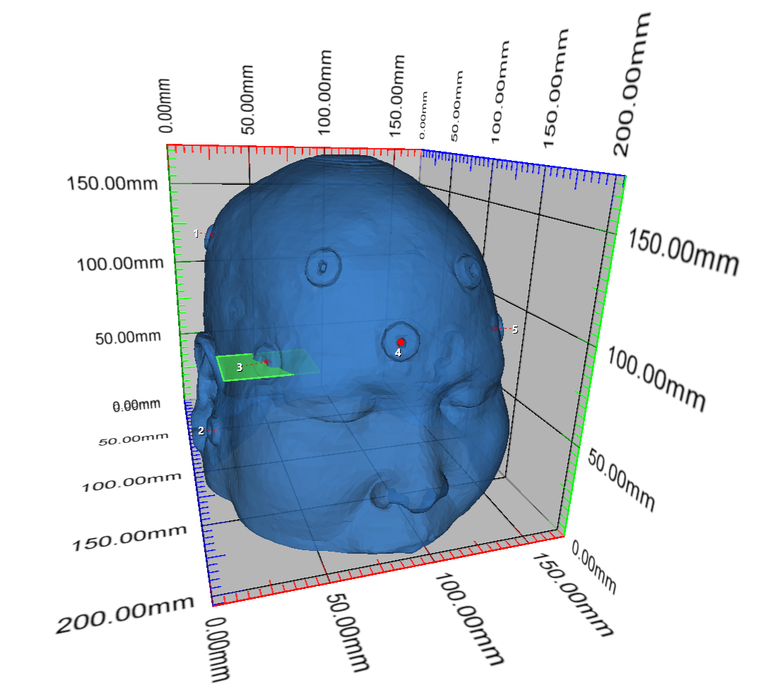
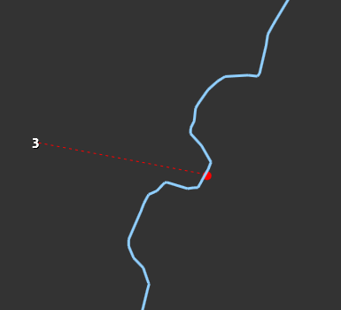

Slide 7
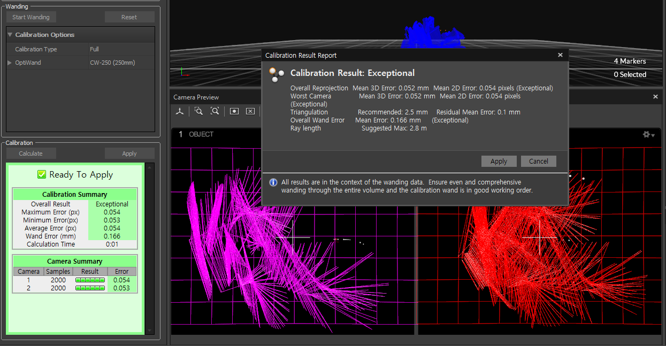

Slide 8
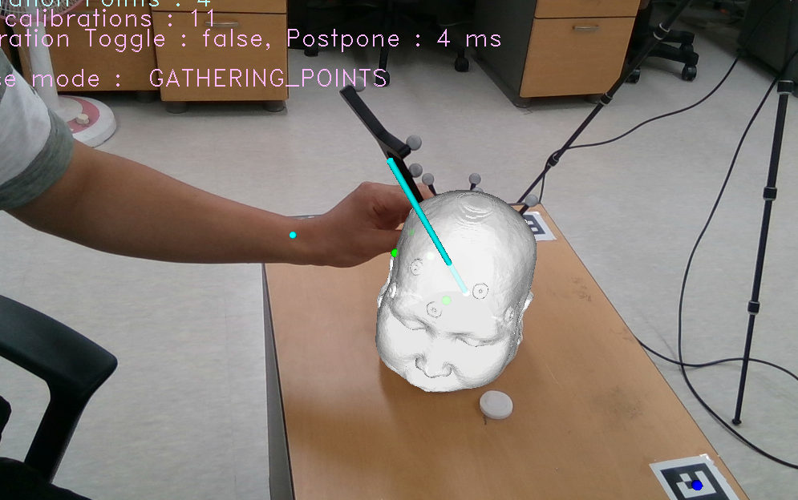


Slide 9
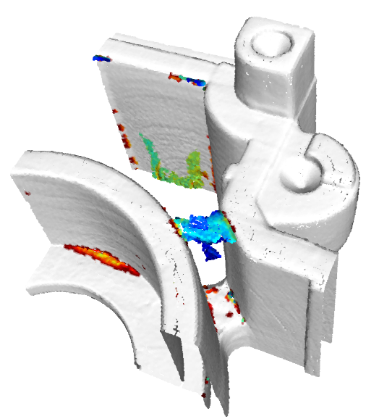
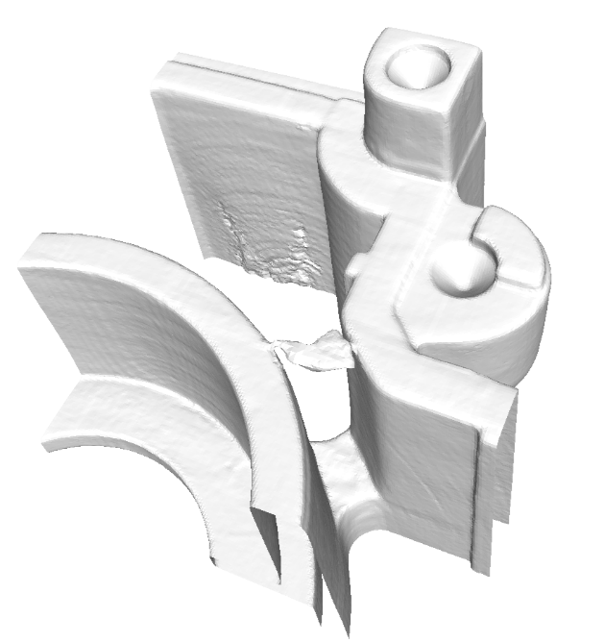
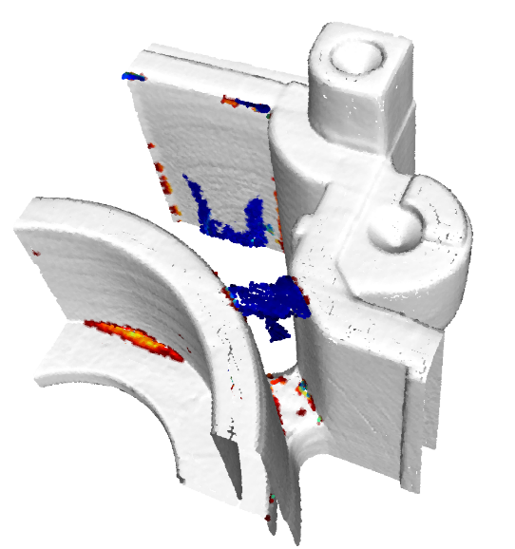
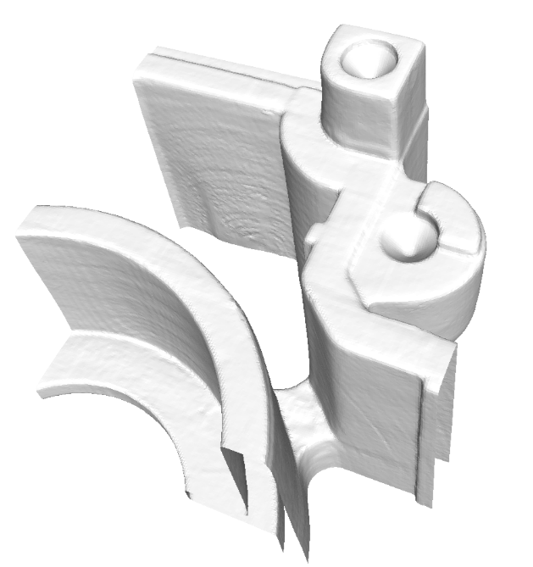
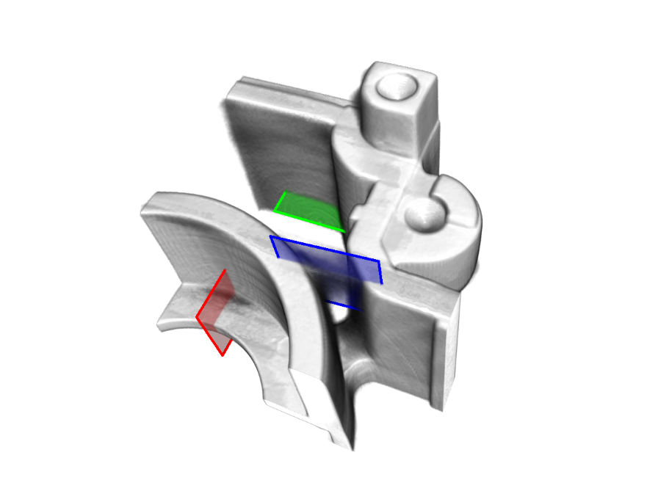
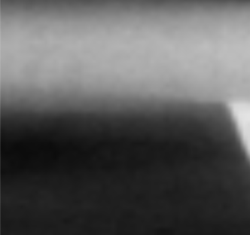
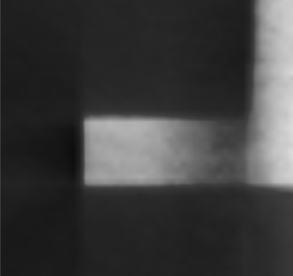
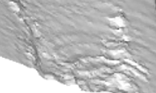
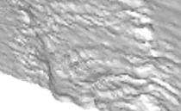
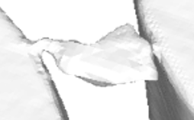
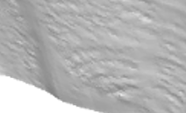
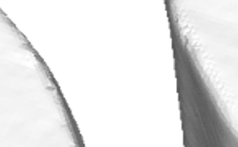
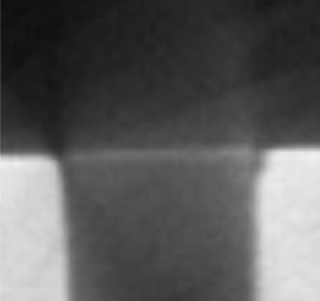
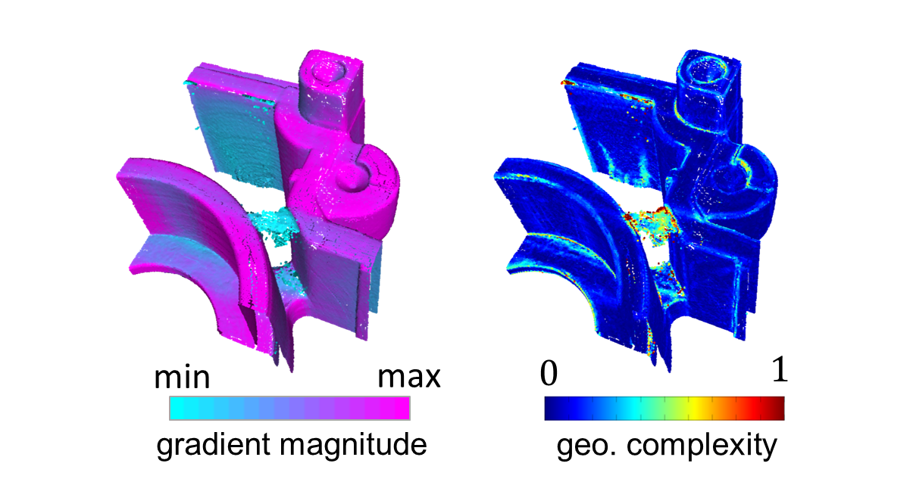
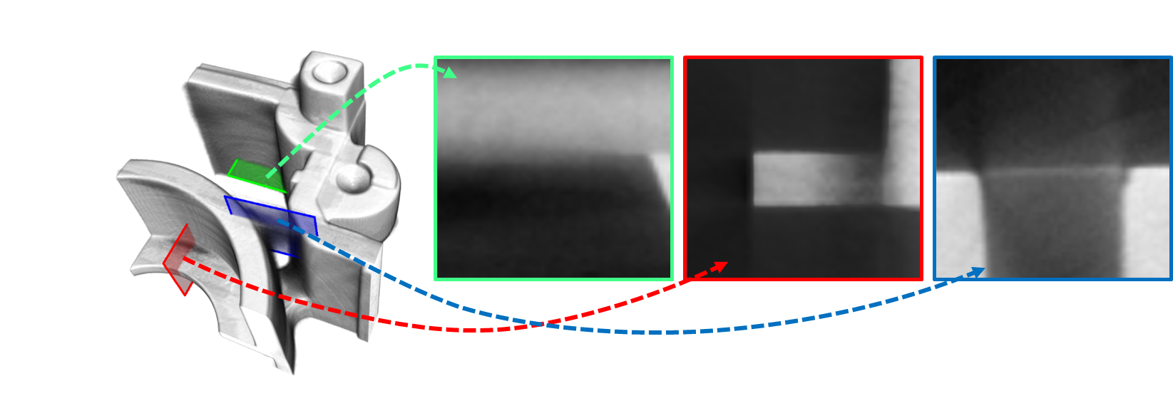
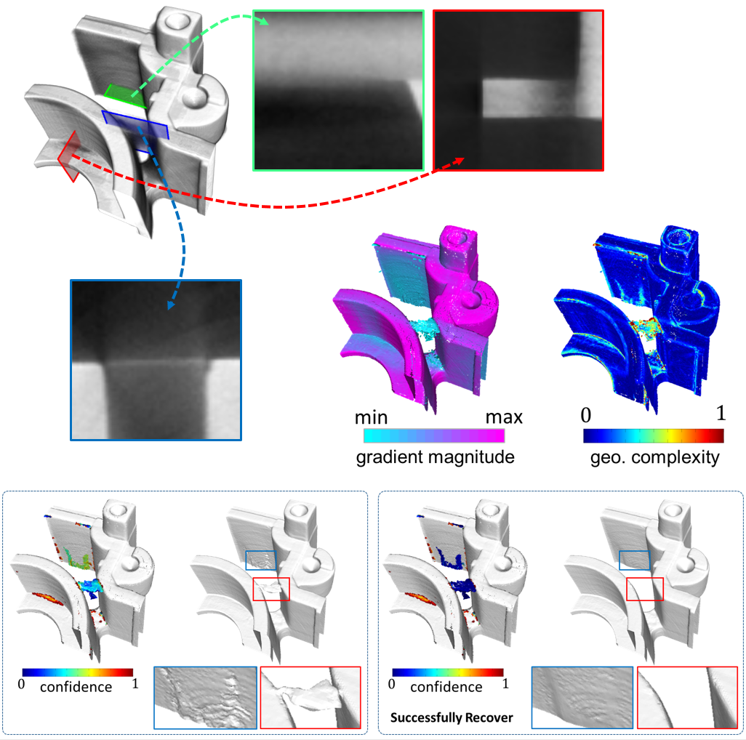
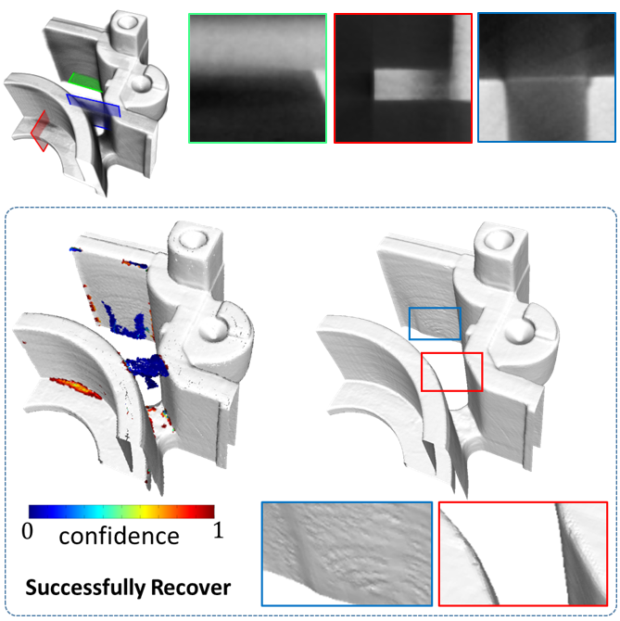
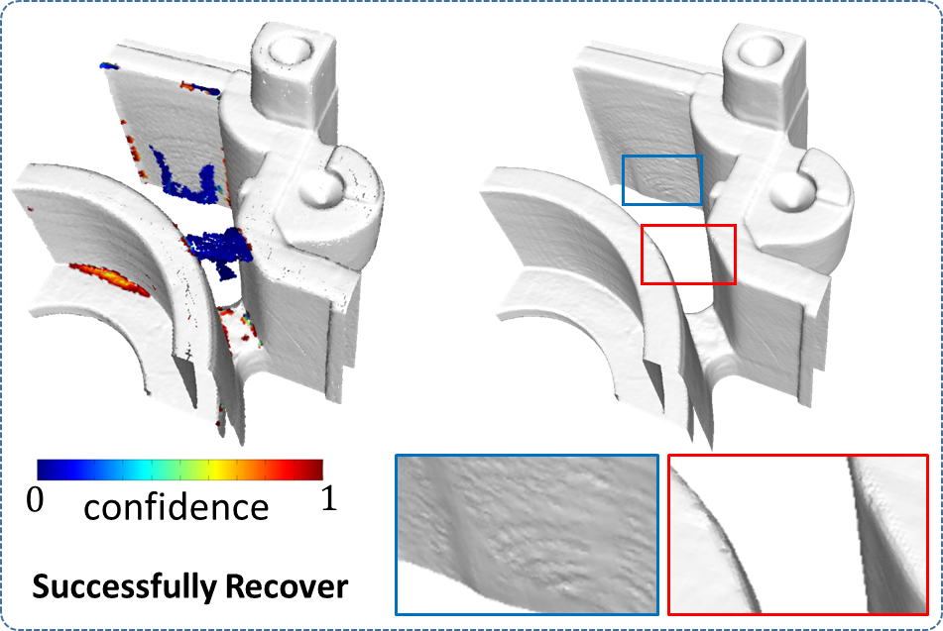
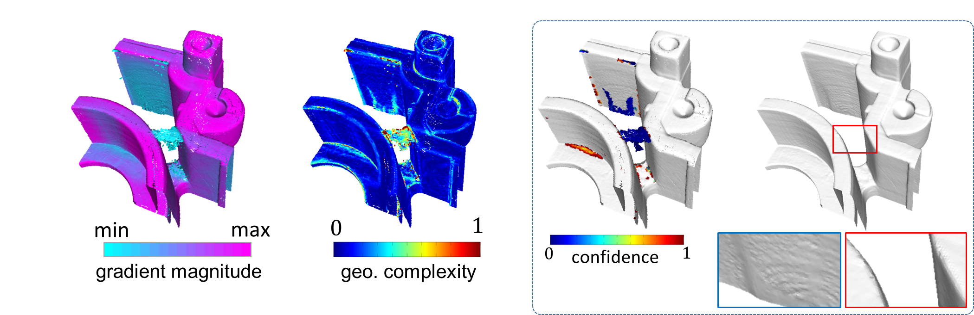
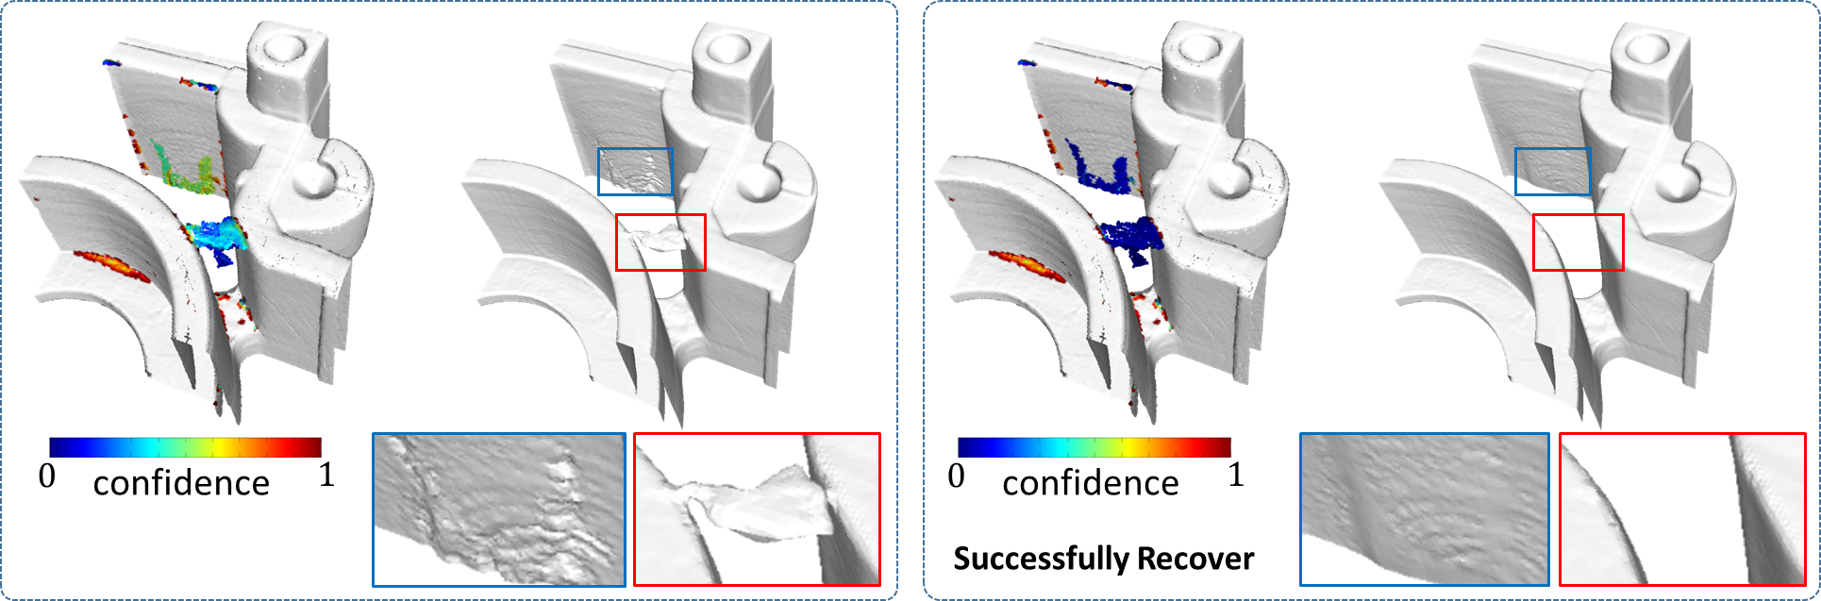
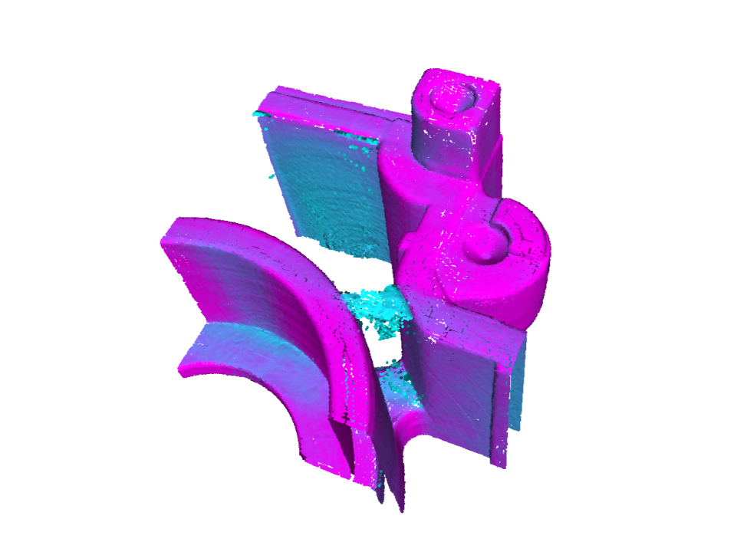
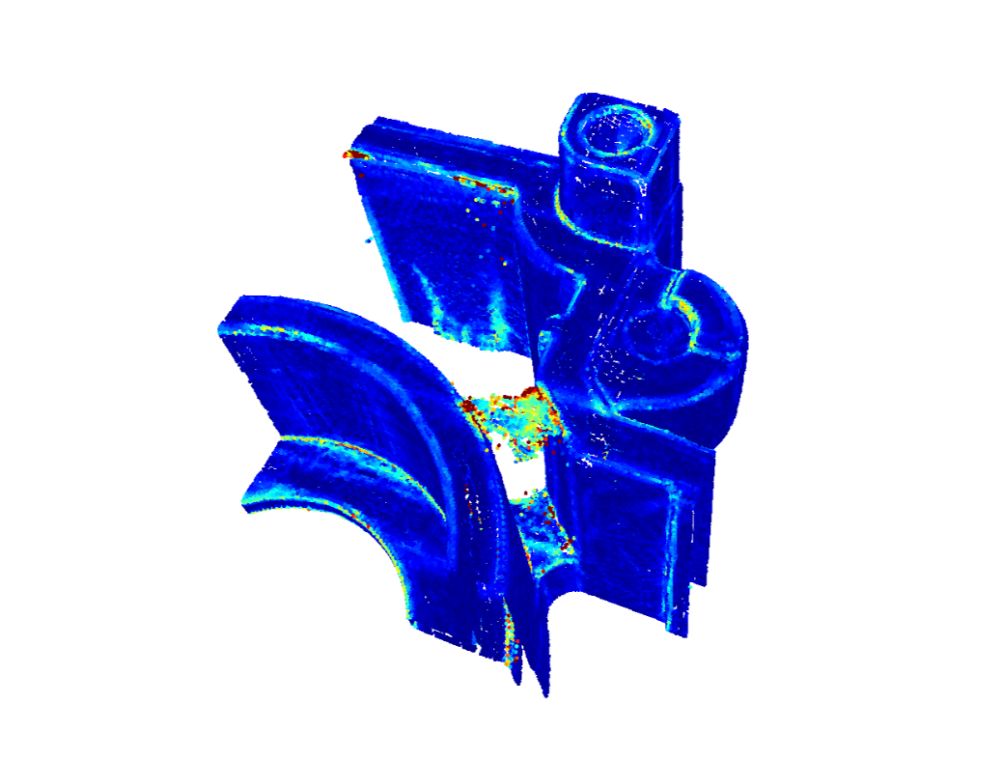
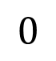

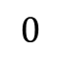
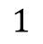
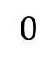
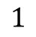

$$1$$
$$1$$
confidence
confidence
Successfully Recover
$$0$$
$$0$$
max
$$1$$
gradient magnitude
geo. complexity
min
$$0$$

Slide 10
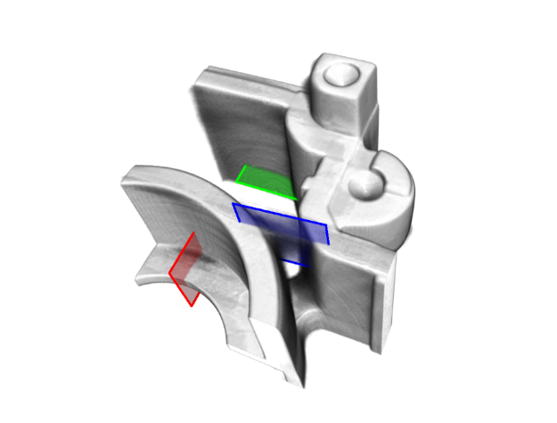
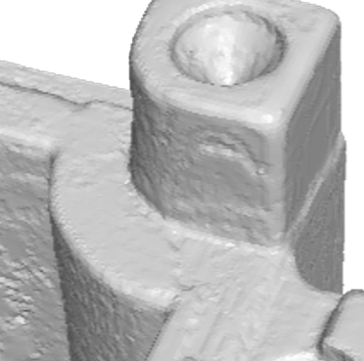
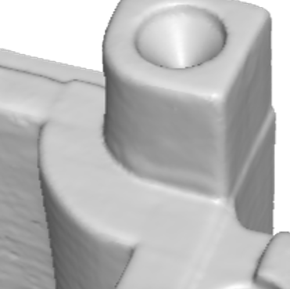
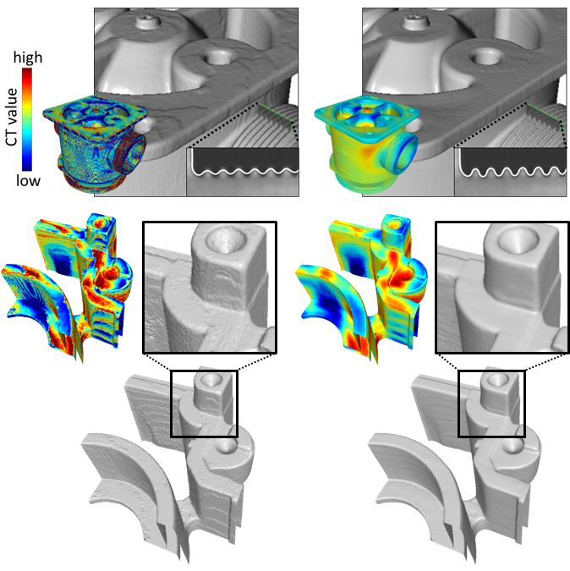
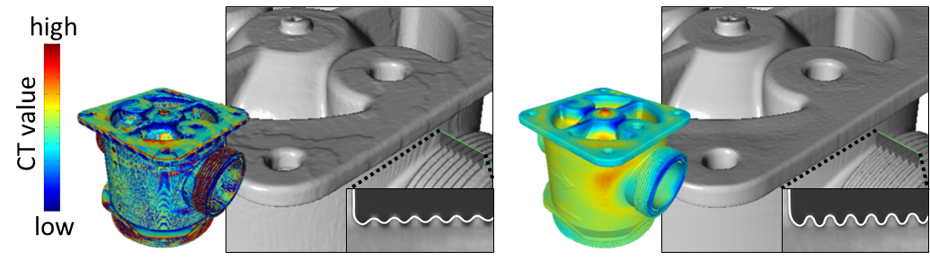
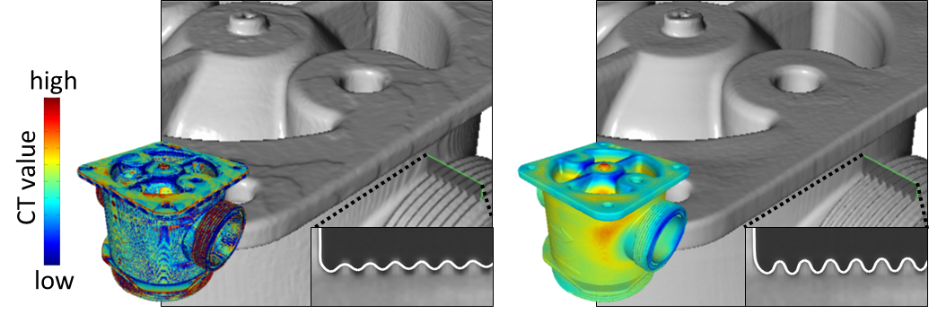
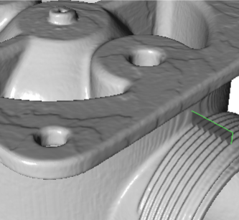
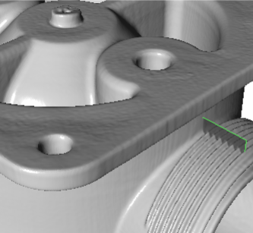
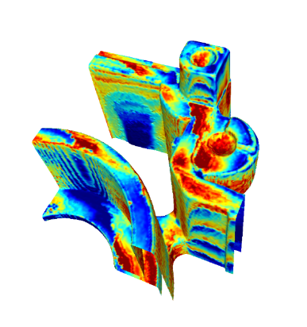
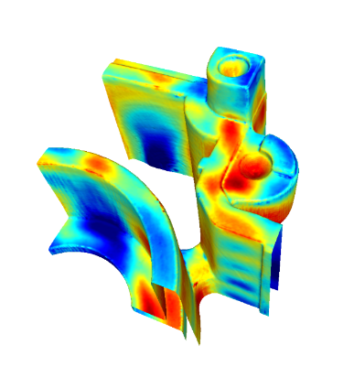
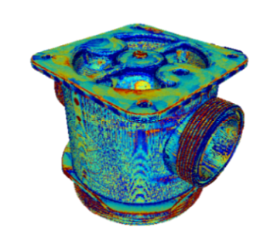
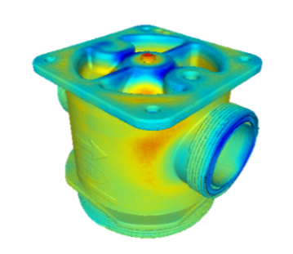
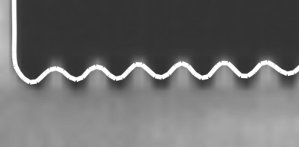
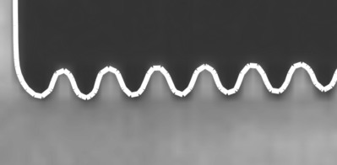
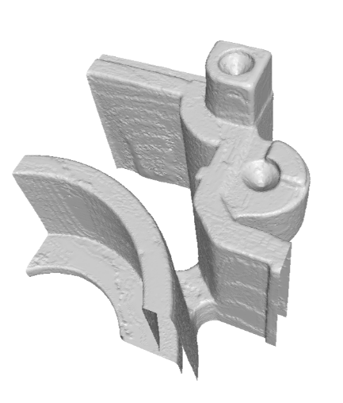

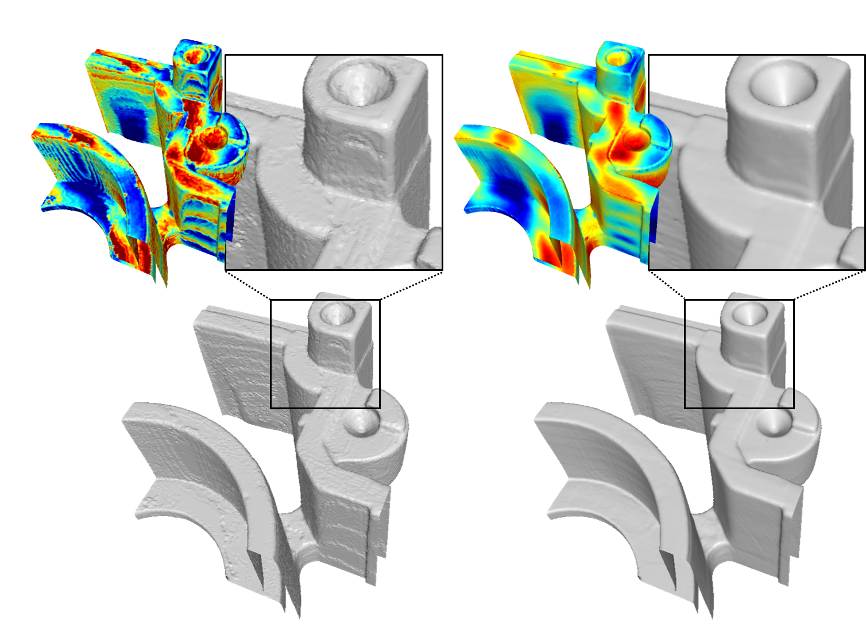
high
CT value
low
high
CT value
low

Slide 11





Slide 12
os RS : -0.573557, 0.587879, -0.0602987
dir RS : 0.837494, -0.485164, 0.251437
up RS : 0.457029, 0.874127, 0.164397
intrinsics STG : 3642.02, 3607.22, 30.3996, 2489.27, 1370.48, 1280x720
intrinsics RS : 924.836, 923.76, 0, 621.001, 334.326, 1280x720
pos STG : -0.560903, 0.586759, -0.0469089
dir STG : 0.832759, -0.498197, 0.24148
up STG : 0.469248, 0.866612, 0.169674
pos RS : -0.573546, 0.587874, -0.0603204
dir RS : 0.837534, -0.485077, 0.251472
up RS : 0.456957, 0.874177, 0.164334
intrinsics STG : 3642.02, 3607.22, 30.3996, 2489.27, 1370.48, 1280x720
intrinsics RS : 924.836, 923.76, 0, 621.001, 334.326, 1280x720
pos STG : -0.560922, 0.586742, -0.0469297
dir STG : 0.832636, -0.49845, 0.241382
up STG : 0.469506, 0.866467, 0.169702
pos RS : -0.573566, 0.587862, -0.0603403
dir RS : 0.837415, -0.485332, 0.251374
up RS : 0.457217, 0.874035, 0.164363
intrinsics STG : 3642.02, 3607.22, 30.3996, 2489.27, 1370.48, 1280x720
intrinsics RS : 924.836, 923.76, 0, 621.001, 334.326, 1280x720
pos STG : -0.560901, 0.586754, -0.0469136
dir STG : 0.832736, -0.498234, 0.241484
up STG : 0.469298, 0.866592, 0.169637
pos RS : -0.573544, 0.58787, -0.0603251
dir RS : 0.837511, -0.485114, 0.251475
up RS : 0.

Slide 13




Slide 14


Slide 15


Slide 16


Slide 17



Slide 18


